Slide 1
Chinese Remainder Theorem and Its Applications
Vũ Minh Hưng - Lê Kim Dũng
August - 2022

Slide 2
Let begin with a game:
“There are certain things whose number is unknown. If we count them by threes, we have two left over; by fives, we have three left over; and by sevens, two are left over. How many things are there?”

Slide 3
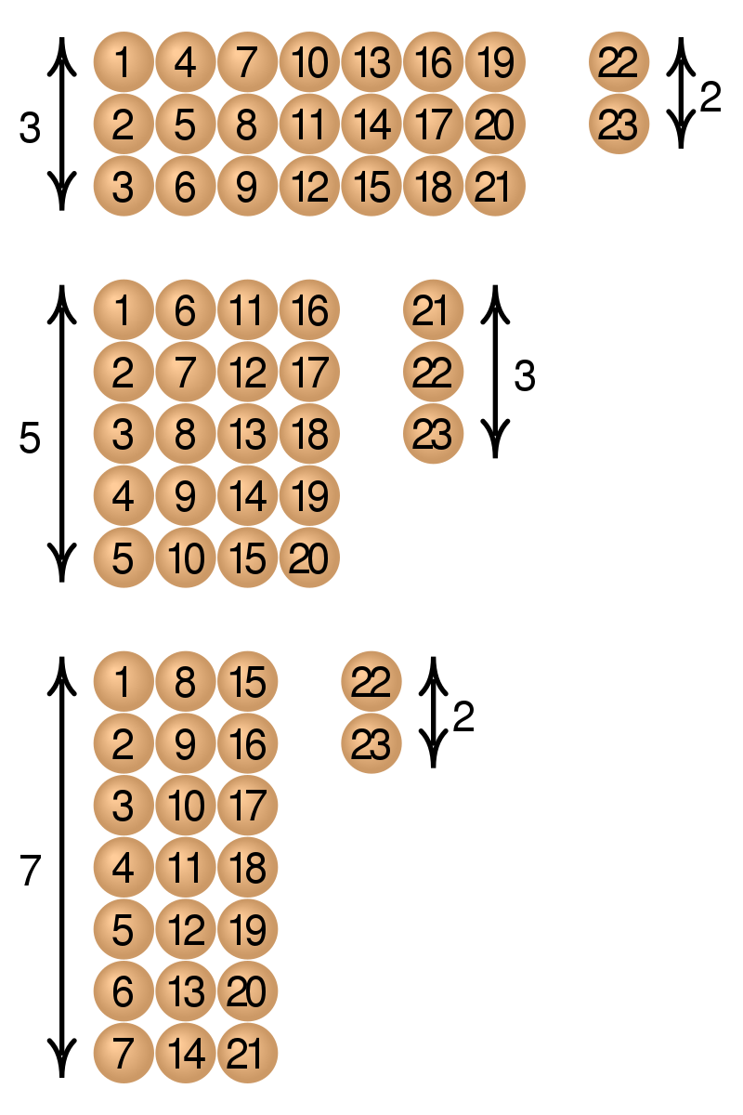
Let begin with a game:
x ≡ 2 (mod 3)
x ≡ 3 (mod 5)
x ≡ 2 (mod 7)
=> x = 23 + (3*5*7)k, with k an integer

Slide 4
Vocabularies:
Divisor: ước
Multiple: bội
Pairwise coprime: nguyên tố cùng nhau
Congruence: đồng dư
Divisor: ước
Multiple: bội

Slide 5
I. The origins of the Chinese Remainder Theorem:
The earliest known statement of the theorem, as a problem with specific numbers, appears in the 3rd-century book by the Chinese mathematician Sun-tzu.
The Chinese used its algorithm to calculate the calendar, compute the number of soldiers when marching in lines, or compute the construction of building a Wall.

Slide 6

II. Statement:
Let n₁, ..., n_{k} be integers greater than 1. Let us denote by N the product of the n_{i}.
If the n_{i} are pairwise coprime, and if a₁, ..., a_{k} are integers such that 0 ≤ a_{i} < n_{i} for every i, then there is one and only one integer x , such that 0 ≤ x < N and the remainder of the Euclidean division of x by n_{i} is a_{i} for every i.

Slide 7
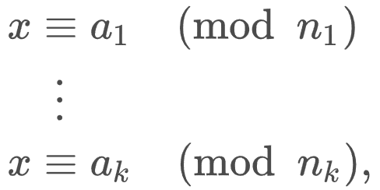

II. Statement:
This may be restated as follows in terms of congruences: If the n_{i} are pairwise coprime, and if a₁, ..., a_{k} are any integers, then the system
has a solution, and any two solutions, say x₁ and x₂, are congruent modulo N, that is:
$$x_{1}≡x_{2} \left(mod N\right)$$

Slide 8
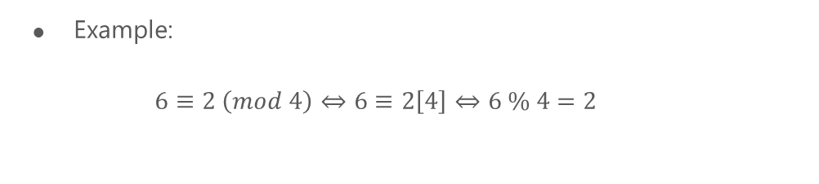
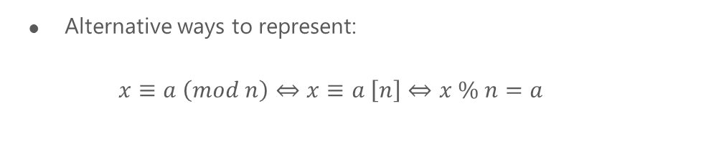
II. Statement:
Alternative ways to represent:
$x≡a \left(mod n\right)⇔x≡a \left[n\right]⇔x \% n=a$
Example:
$6≡2 \left(mod 4\right)⇔6≡2\left[4\right]⇔6 \% 4=2$

Slide 9
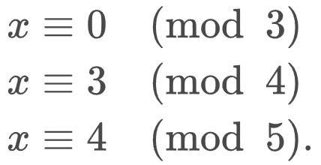
III. Several ways to solve:
Systematic search:
n1, n2, n3 = 3, 4, 5
N = n1 * n2 * n3
x = 0
while x < N:
if x % 3 == x % 4 - 3 == x % 5 - 4 == 0:
return x
=> O(N)

Slide 10
III. Several ways to solve:
Search by sieving:
n₁, n₂, n₃ = 3, 4, 5
while True:
4 mod 4 = 0. Continue
4 + 5 = 9 mod 4 →1. Continue
9 + 5 = 14 mod 4 → 2. Continue
14 + 5 = 19 mod 4 → 3. OK, continue by considering remainders modulo 3 and adding 5 × 4 = 20 each time
19 mod 3 → 1. Continue
19 + 20 = 39 mod 3 → 0
=> O(N)

Slide 11
IV. Exercises:
Problem 1: ${13}^{3}\left[55\right]= ?$

Slide 12
IV. Exercises:
${13}^{3}[5]$ = $3^{3}\left[5\right]=2$
${13}^{3}[11]$ = $2^{3}\left[11\right]=8$
${13}^{3}[55]$ $=52$

Slide 13
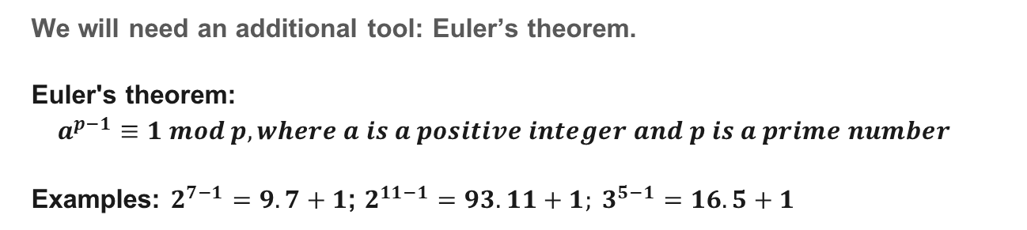
IV. Exercises:
Problem 2: $52^{27}\left[55\right]= ?$
We will need an additional tool: Euler’s theorem.
Euler's theorem:
$$a^{p−1}≡1 mod p, where a is a positive integer and p is a prime number$$
Examples: $2^{7−1}=9.7+1$; $2^{11−1}=93.11+1; 3^{5−1}=16.5+1$

Slide 14
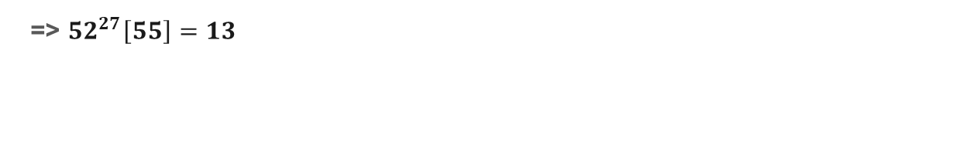
IV. Exercises:
$$52^{27}\left[5\right]=2^{27}\left[5\right]=2^{4x6+3} \left[5\right]=8\left[5\right]=3$$
$$52^{27}\left[11\right]={(44+8)}^{27} \left[11\right]=2^{81}\left[11\right]= 2$$
=> $52^{27}\left[55\right]=13$

Slide 15

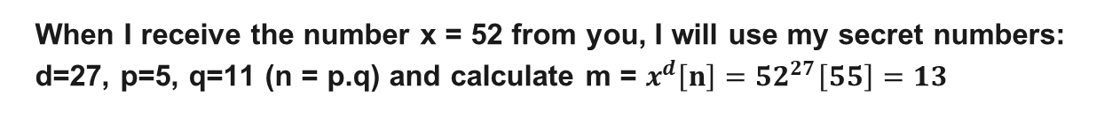
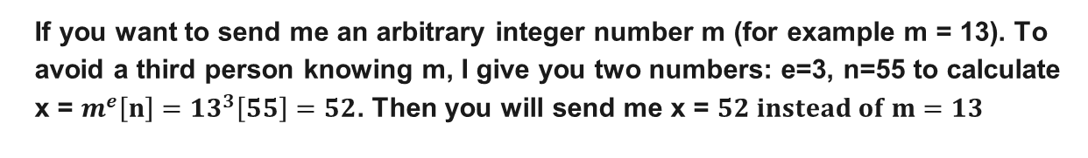
RSA
If you want to send me an arbitrary integer number m (for example m = 13). To avoid a third person knowing m, I give you two numbers: e=3, n=55 to calculate x = $m^{e}\left[n\right]={13}^{3}\left[55\right]=52$. Then you will send me x = $52 instead of m=13$
When I receive the number x = 52 from you, I will use my secret numbers: d=27, p=5, q=11 (n = p.q) and calculate m = $x^{d}\left[n\right]={52}^{27}\left[55\right]=13$
Above is the operation of RSA, a public-key cryptosystem, where (e, n) is the public key, (d, n) is the private key and an arbitrary message m:

Slide 16
RSA
Key generation
From two prime numbers: p, q (for example p=5, q = 11)
n = p.q = 55
a = (p-1)(q-1) = 40
Choose an integer e such that 1 < e < a and gcd(e, a) = 1 (gcd stand for greatest common divisor)
Calculate d: e.d ≡ 1 mod a, d = 27
In case p, q is very large, knowing e and n, it can be extremely difficult to find d

Slide 17
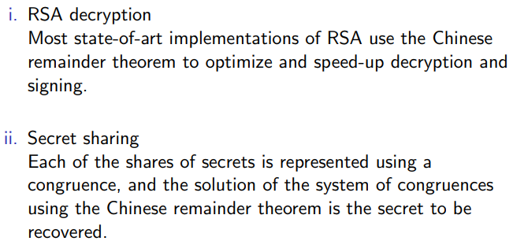
V. Applications: Cryptography

Slide 18
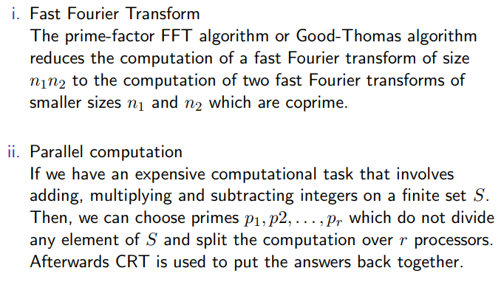
V. Applications: Fast computation

Slide 19


